Slide 1
Compilers 101
Intro

Slide 2
Course overview
Intro (this lecture)
Compiler frontend
Static analysis
Intermediate representations
Optimizations
Backend
Debuggers
Heterogeneous compilers

Slide 3
Contacts
Lectures: Оболенский Арсений
E-mail: me@gooddoog.ru
Via portal.unn.ru
Practice: Лычков Михаил
E-mail: mikelitch@gmail.com
Practice: Кузнецов Артём
E-mail: artyomka6192@gmail.com
GitHub organization: https://github.com/NN-complr-tech
Lecture materials repository: https://github.com/NN-complr-tech/Complr-course-lectures

Slide 4
What is a compiler?
Source code
Magic
Executable

Slide 5

First compilers
A-0, 1952
Grace Hopper at Remington Rand
Not a real compiler, functioned more as a loader and a linker
Photo: https://en.wikipedia.org/wiki/Grace_Hopper

Slide 6
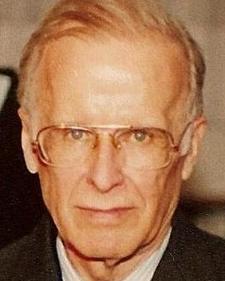
Fortran
1954-1957
John Backus at IBM
Fortran is still used and actively developed by ISO. The last release is Fortran 2018.
Photo: https://en.wikipedia.org/wiki/John_Backus

Slide 7
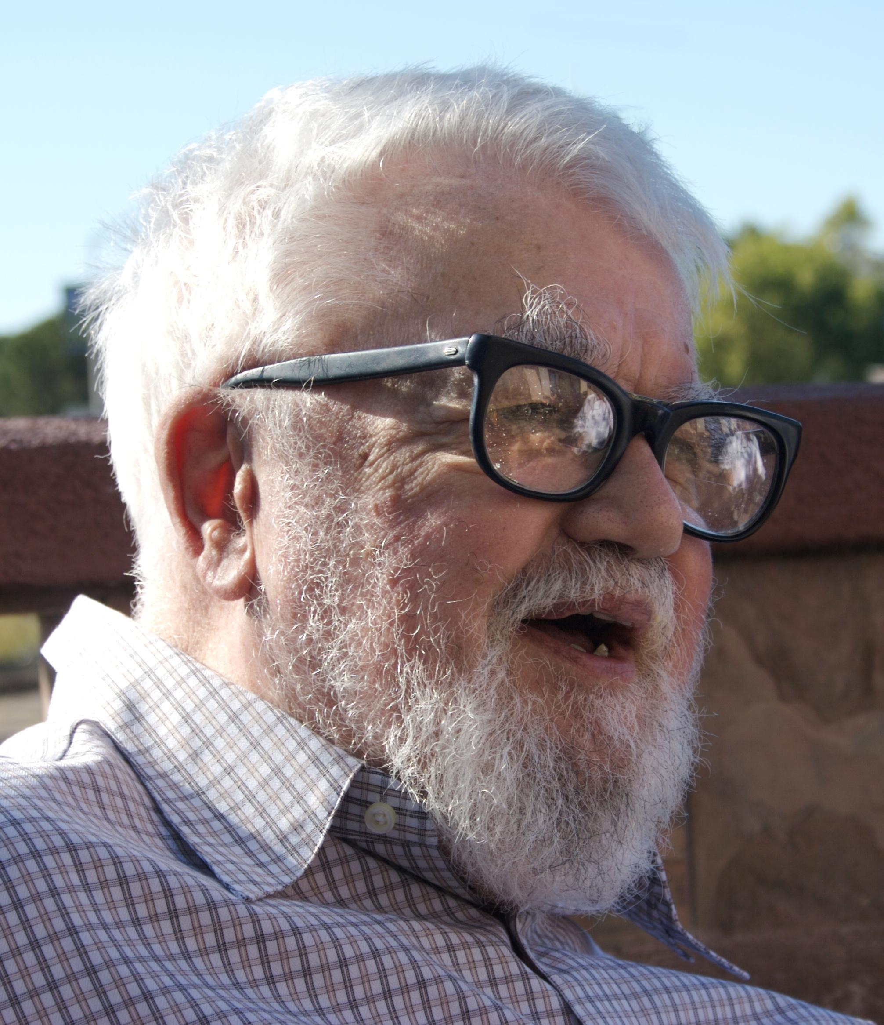
Lisp
1958
John McCarthy at MIT
Second-oldest high-level programming language
Photo: https://en.wikipedia.org/wiki/John_McCarthy_(computer_scientist)

Slide 8

C
1972
Dennis Ritchie at Bell Labs
Developed the first C compiler (derived from the B language)
Became the backbone of the Unix operating system
Photo: https://en.wikipedia.org/wiki/Dennis_Ritchie

Slide 9

C++
1979
Created by Bjarne Stroustrup at Bell Labs
Evolved from C to add object-oriented programming features
First commercial implementation released in 1985
Photo: https://www.stroustrup.com/

Slide 10
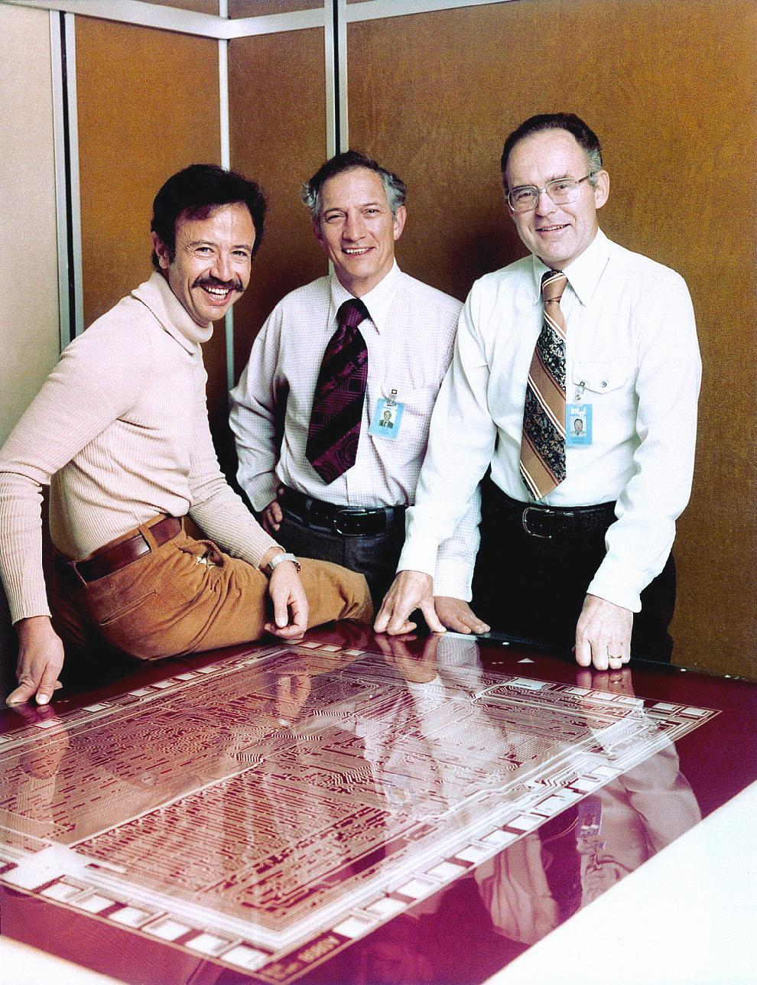
Beyond software
Hardware description languages
Verilog – 1984
VHDL – 1987
OpenCL – 2009
SYCL – 2014
Photo: https://www.flickr.com/photos/intelfreepress/8267616249/in/photostream/lightbox/
Heterogenous calculation languages

Slide 11
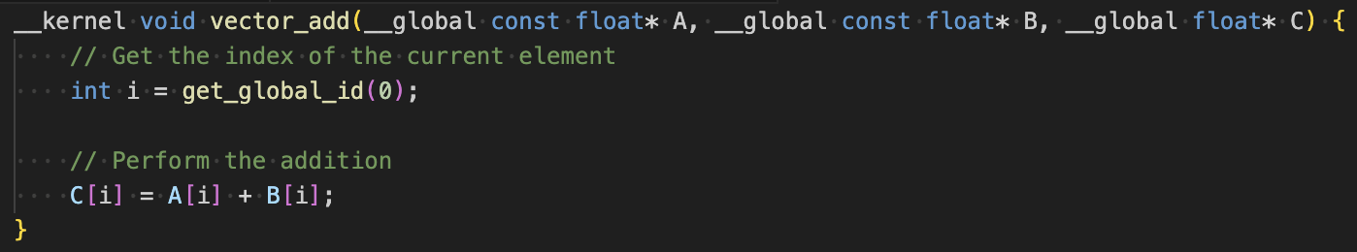
OpenCL
Purpose: Designed for creating programs that leverage the parallel computing capabilities of heterogeneous platforms.
Cross-Platform: Supports a wide range of devices from various manufacturers, including GPUs, CPUs, DSPs, and FPGAs.
Parallel Programming Model: Enables efficient execution of high-performance computing, graphical, and real-time applications.

Slide 12
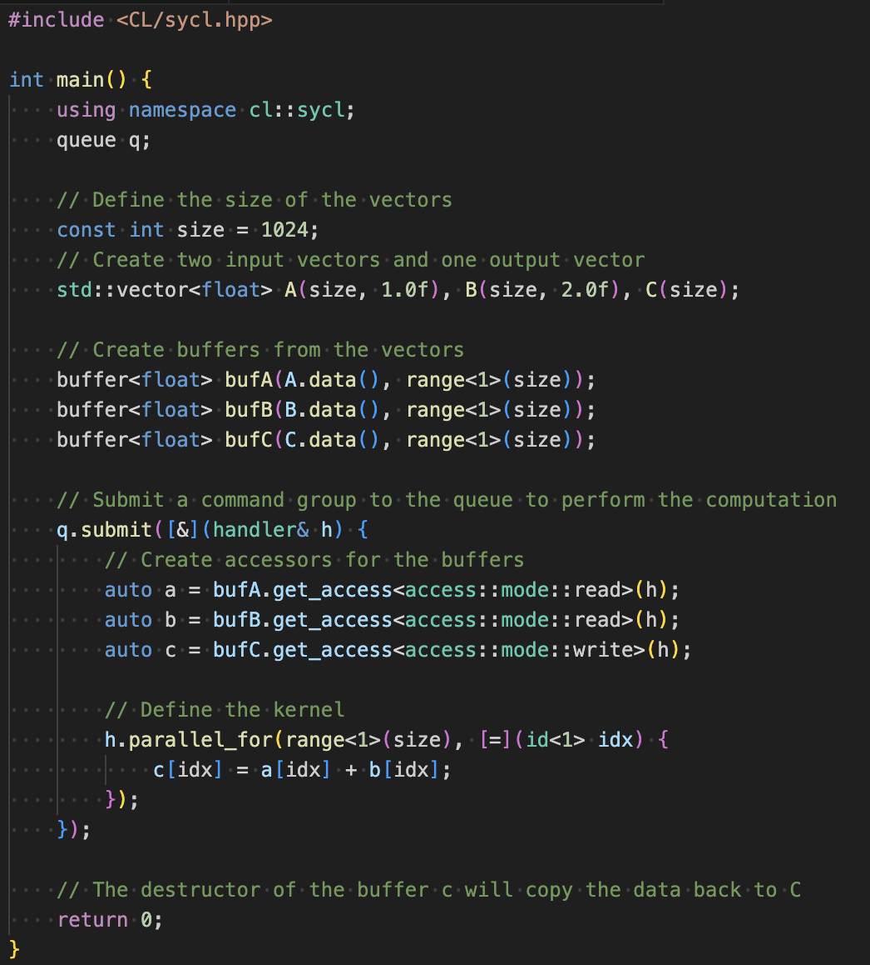
SYCL
SYCL (pronounced "sickle") is a high-level programming model built on top of OpenCL that enables developers to write code for heterogeneous devices (such as CPUs, GPUs, DSPs, and FPGAs) using standard C++.
It abstracts away much of the boilerplate code associated with OpenCL, allowing for easier development of parallel computing applications.

Slide 13
Why study compilers?
Write better software
Compiler is a tool, mastering this tool will help you write fast and reliable software
Compilers are not only about code generation
Static analysis, code-to-code conversion
Example: Intel® DPC++ Compatibility Tool (aka SYCLomatic), https://www.intel.com/content/www/us/en/developer/tools/oneapi/dpc-compatibility-tool.html#gs.p25a6d
Compiler writers get paid!

Slide 14
Course emphasis
Practice oriented
Study modern compiler tooling and infrastructure
Lab assignments
Provide overview of basic algorithms and theory
Non-goal: how to build a complete compiler optimizer
There are lots of links on the slides, make sure to check them out if you want to know more

Slide 15
The rest of this lecture
Hardware architecture refresh
CPUs, GPUs, FPGAs
Just enough to understand the problem
Quick compiler architecture introduction
Overview of practical applications

Slide 16
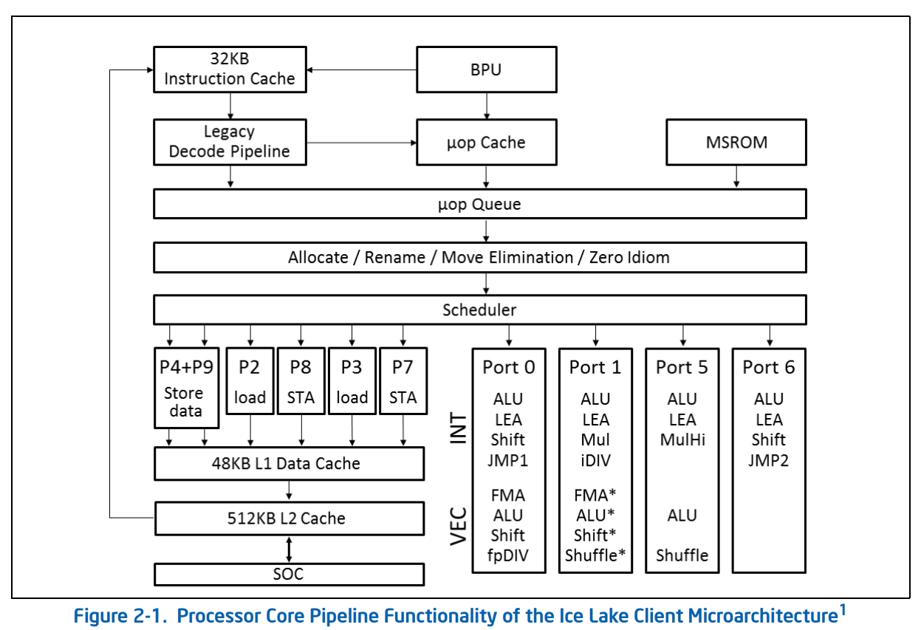
CPUs
https://www.intel.com/content/www/us/en/developer/articles/technical/intel-sdm.html

Slide 17
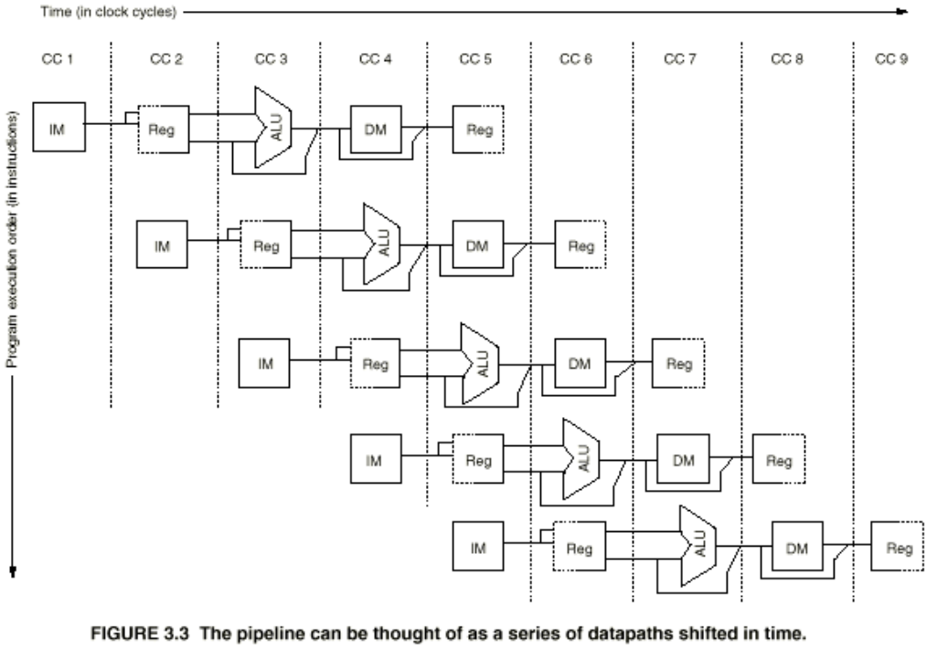
CPU pipeline

Slide 18
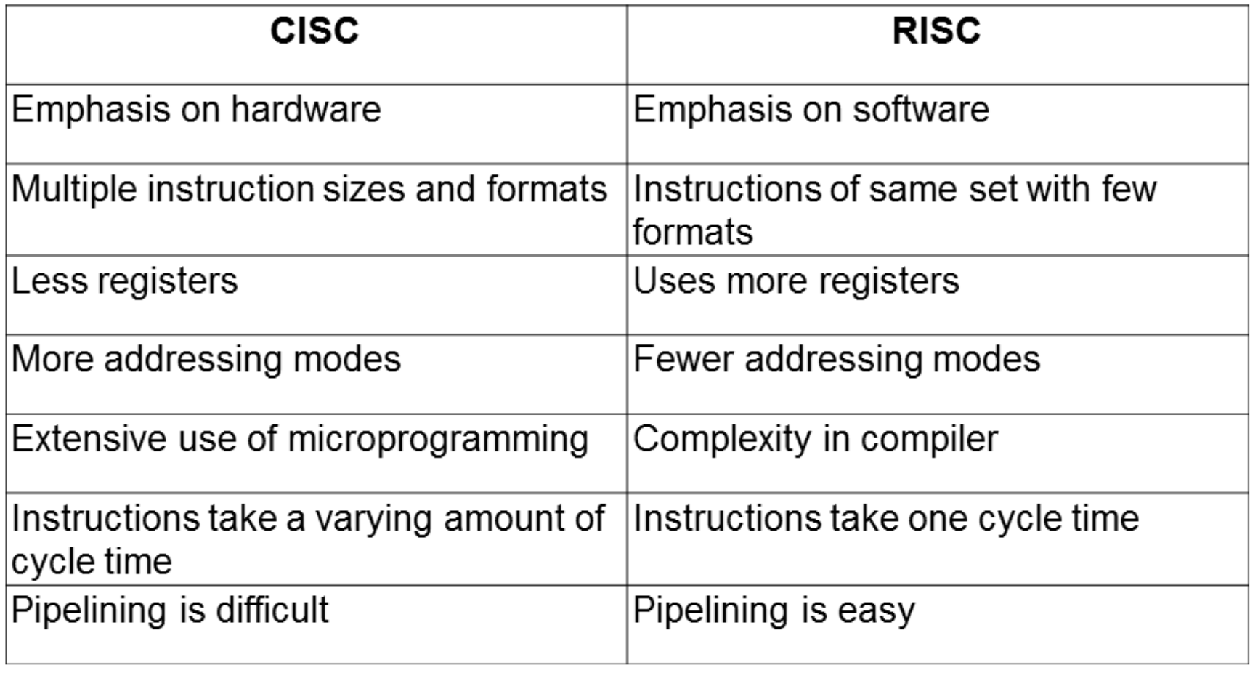
CISC vs RISC
https://csarassignment.files.wordpress.com/2013/05/risc-vs-cisc.png

Slide 19
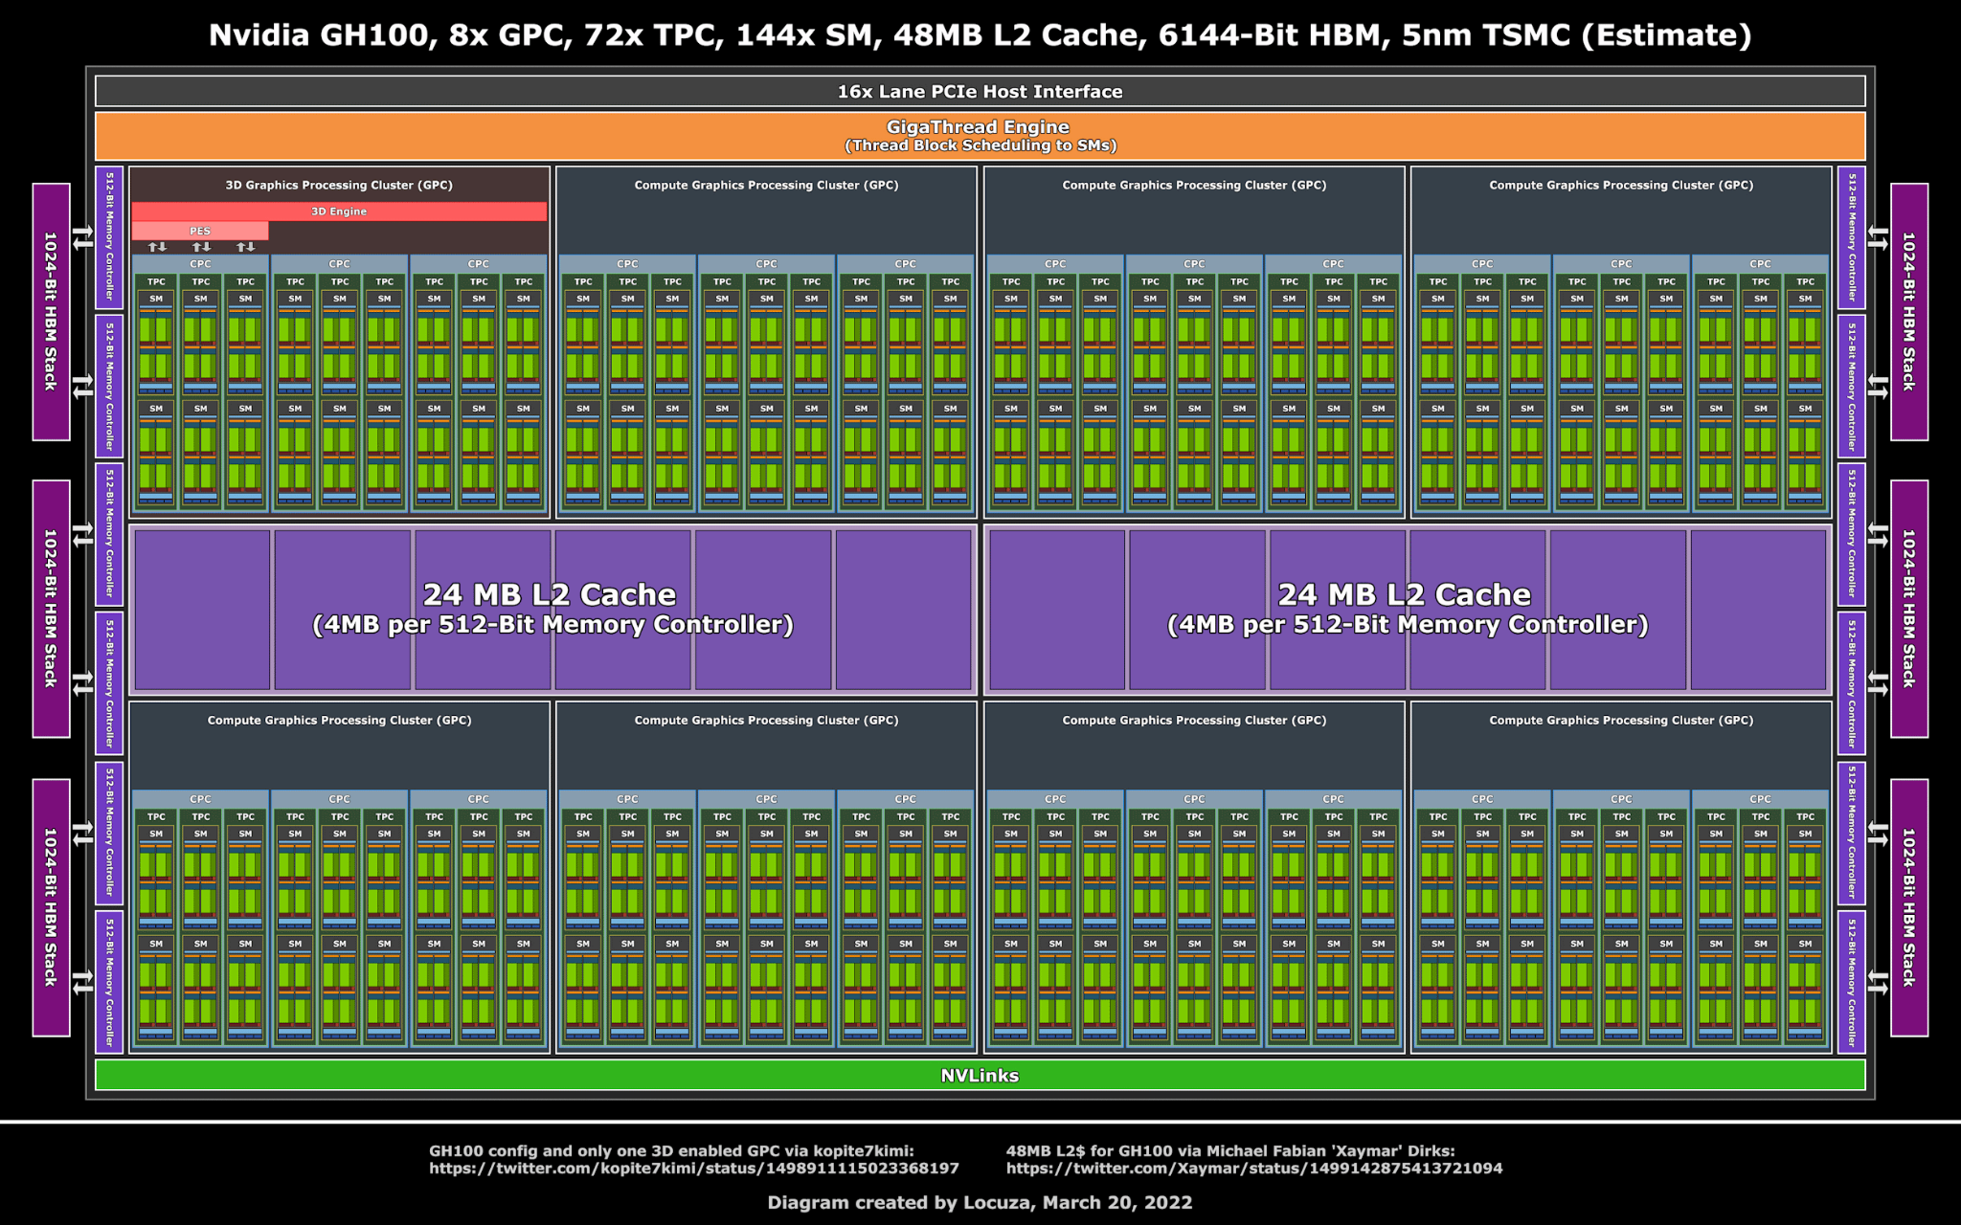
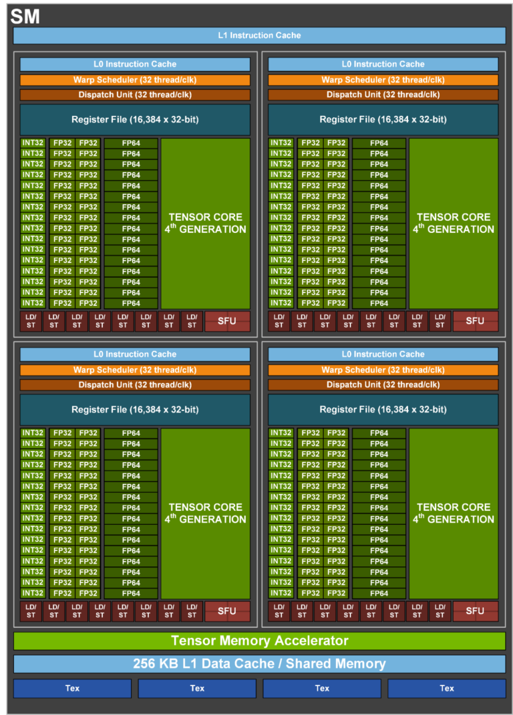
GPUs
https://videocardz.com/newz/nvidia-gh100-hopper-gpu-comes-with-48mb-of-l2-cache-only-one-gpc-has-graphics-enabled https://developer.nvidia.com/blog/nvidia-hopper-architecture-in-depth/

Slide 20
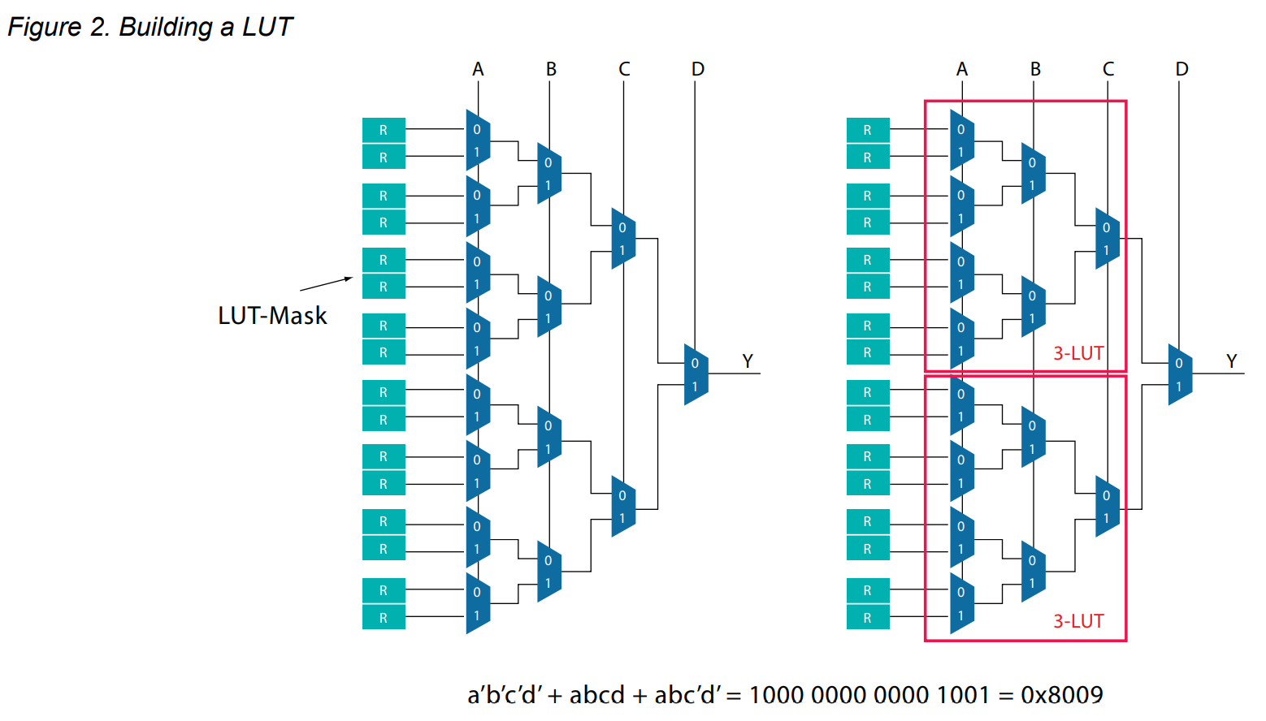
FPGAs
https://www.intel.com/content/dam/www/programmable/us/en/pdfs/literature/wp/wp-01003.pdf

Slide 21
Modern compilers
SRC
Frontend
Middle-end
Backend
Program

Slide 22
Compiler stages
Preprocessing
Lexical analysis
Frontend
Syntax analysis
Semantic analysis
IR Generation
IR Optimization
Middle-end
Optimization
Backend
Code generation

Slide 23
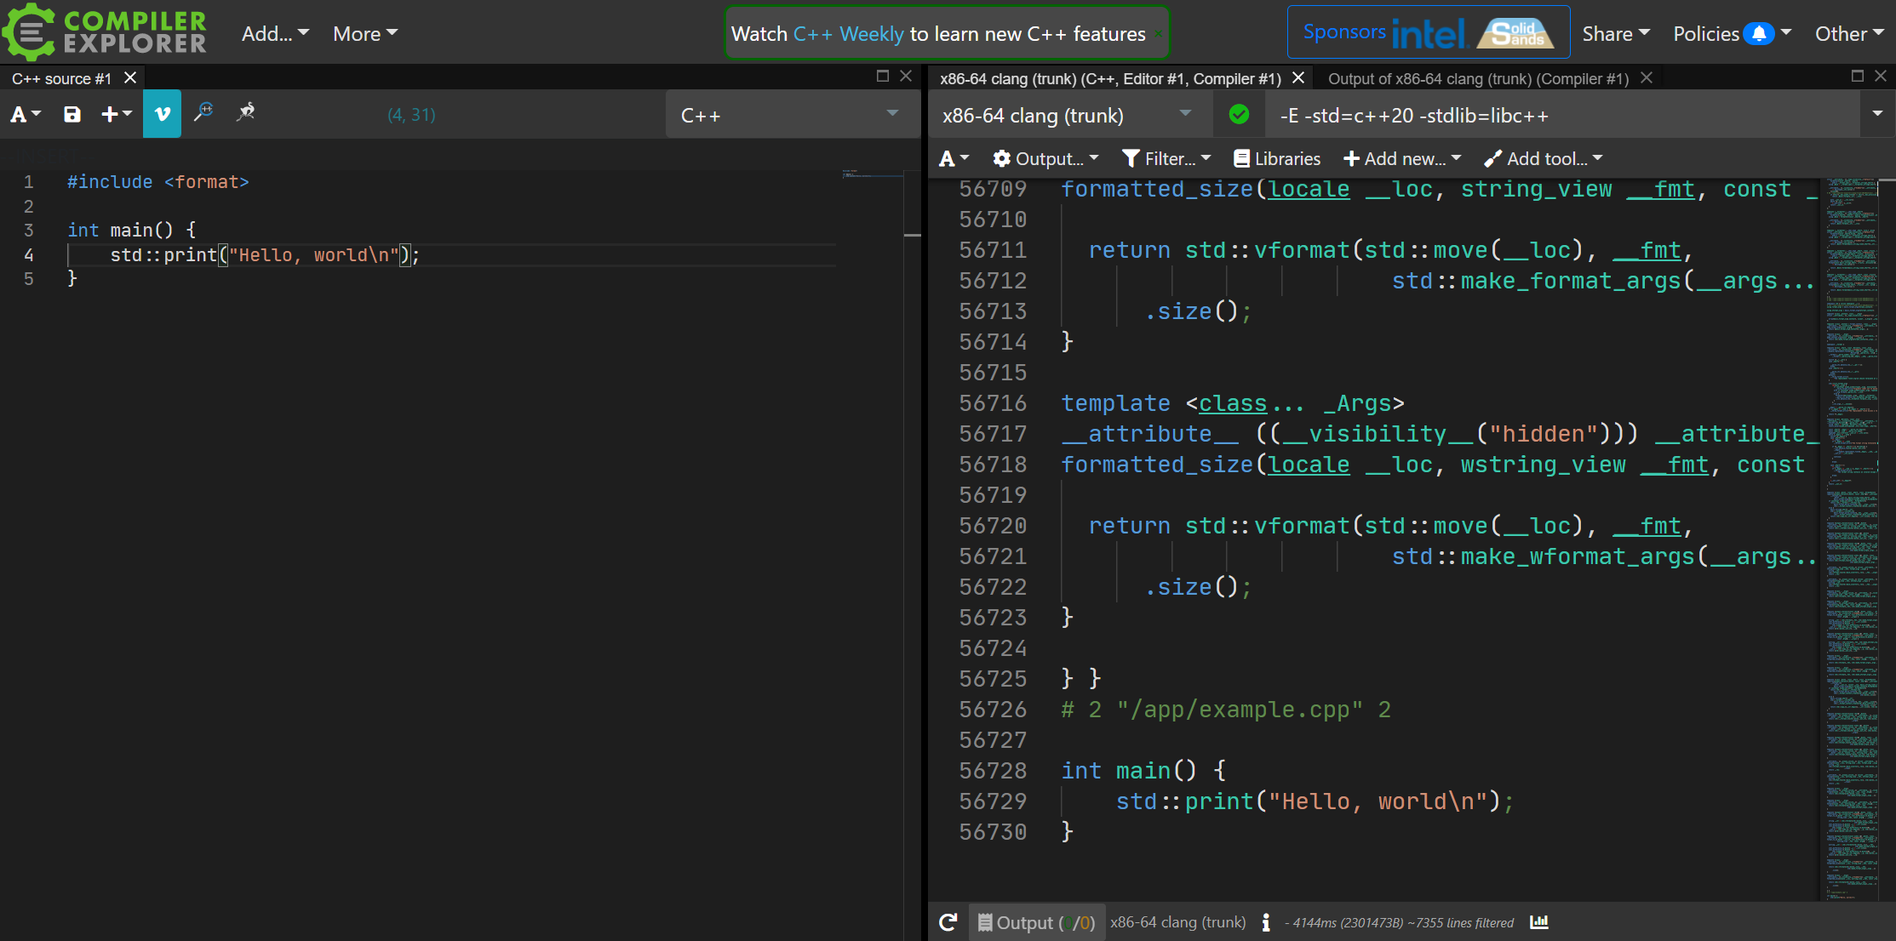

Preprocessing
https://godbolt.org/z/o4K7TYr5E

Slide 24
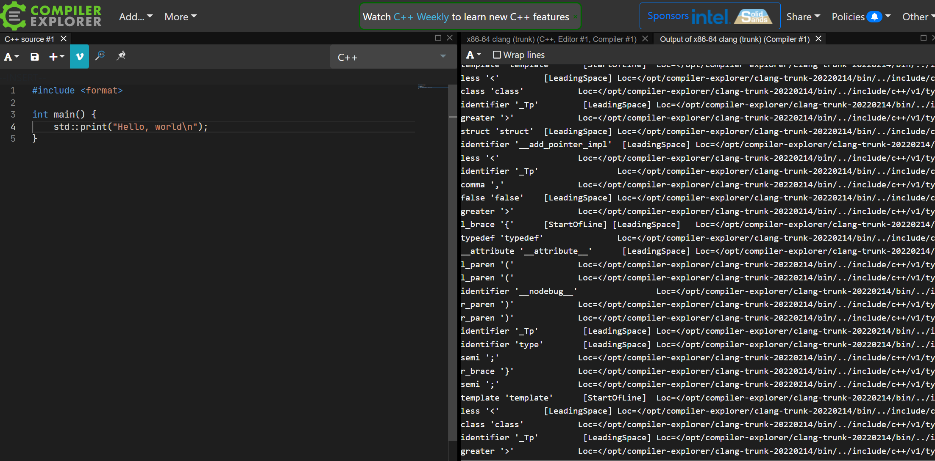
Lexer
https://godbolt.org/z/T6ejdsEba

Slide 25
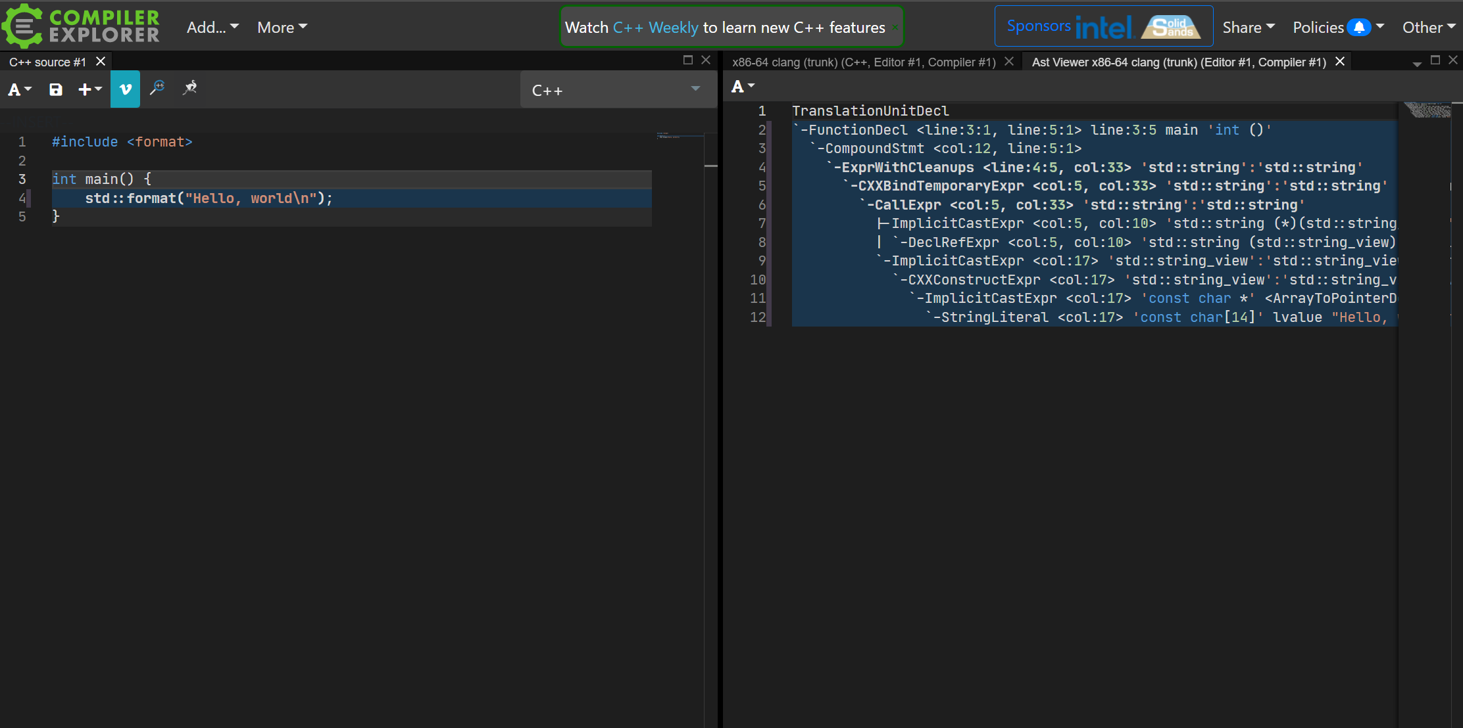
Syntax analysis
https://godbolt.org/z/cz3KjMcYb

Slide 26
Abstract Syntax Tree
FunctionDecl
ParamDecl
CompoundStmt
int foo(int i) {
if (i < 10) {
return i * 2;
}
return i;
}
IfStmt
ReturnStmt
BinaryOperator
CompoundStmt
ReturnStmt
https://godbolt.org/z/6Wq38MbPj

Slide 27
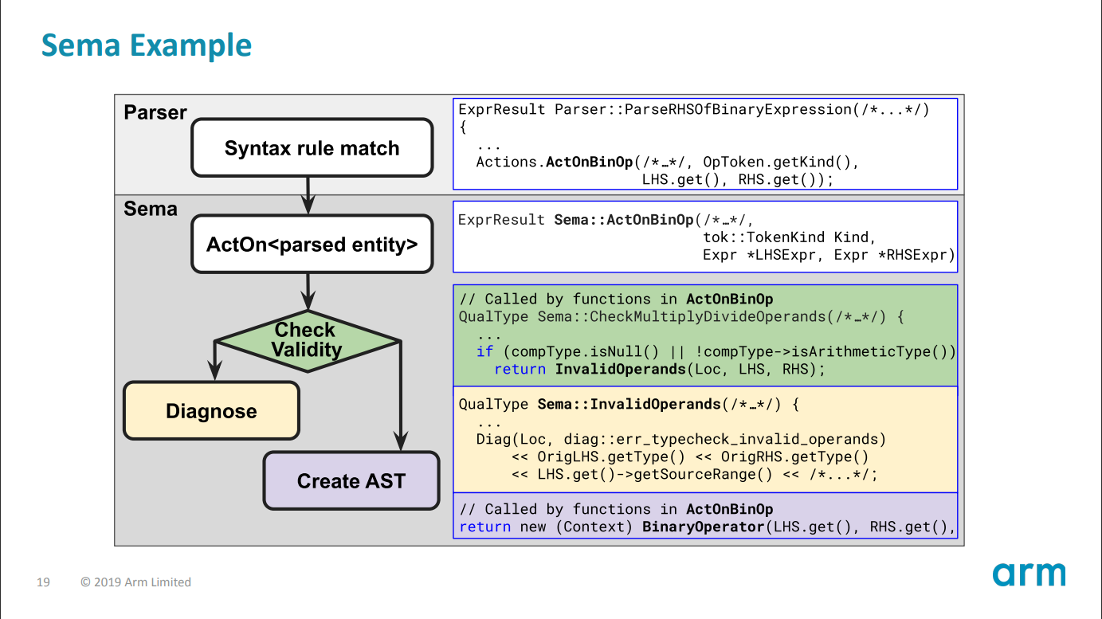
Semantic analysis
https://llvm.org/devmtg/2019-10/slides/ClangTutorial-Stulova-vanHaastregt.pdf

Slide 28
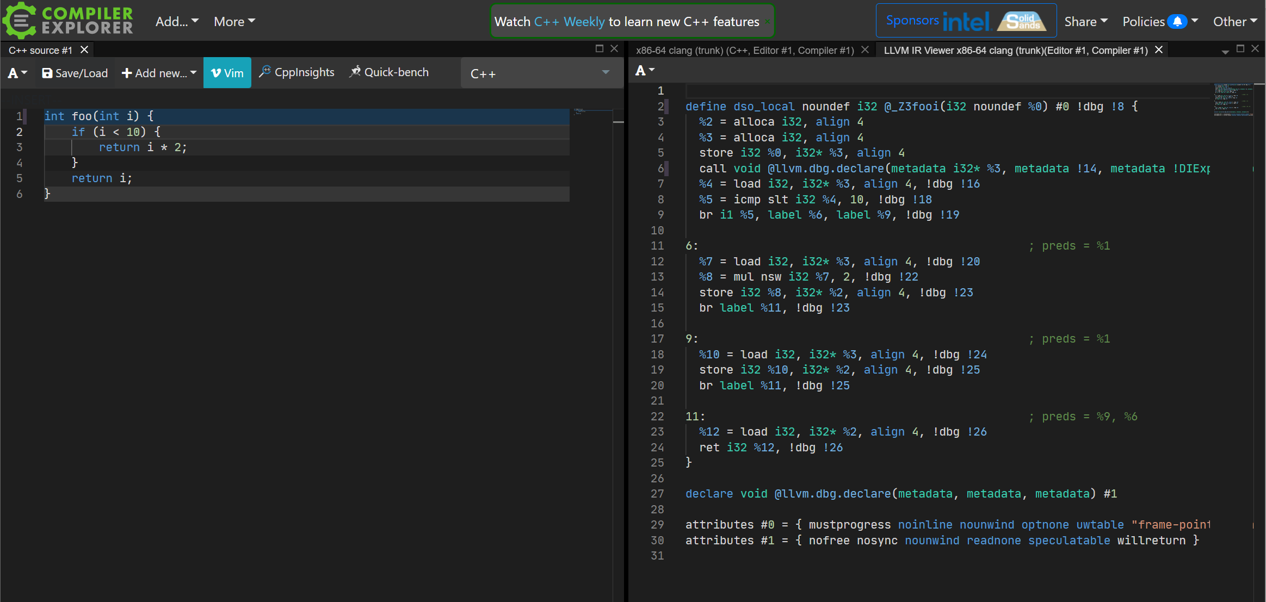
IR generation
https://godbolt.org/z/or3z3oYnq

Slide 29
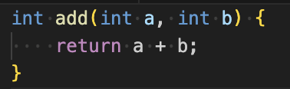
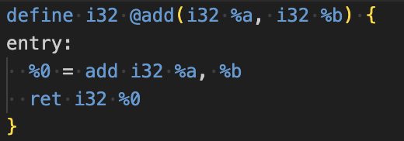
LLVM IR
C++
The corresponding LLVM IR for this function might look something like this:
LLVM
LLVM IR is used for several key purposes within the LLVM compiler framework:
Platform Independence
Optimization
Code Generation

Slide 30
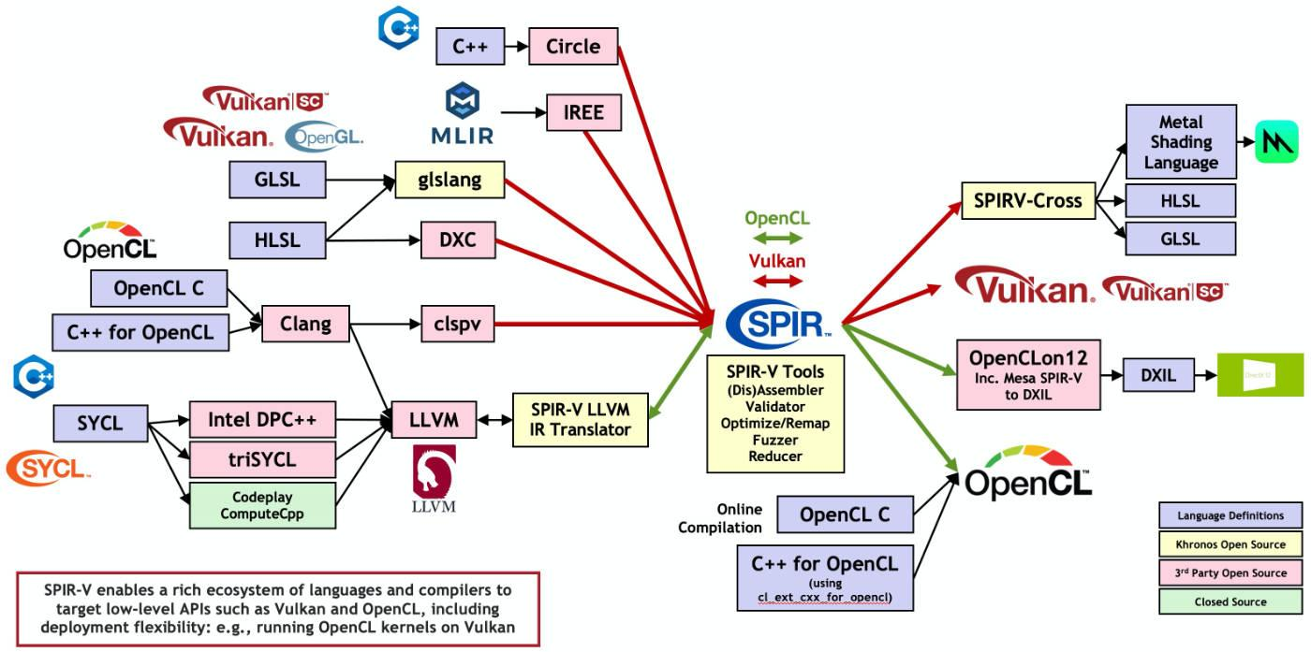
SPIR-V
https://www.khronos.org/spir/

Slide 31
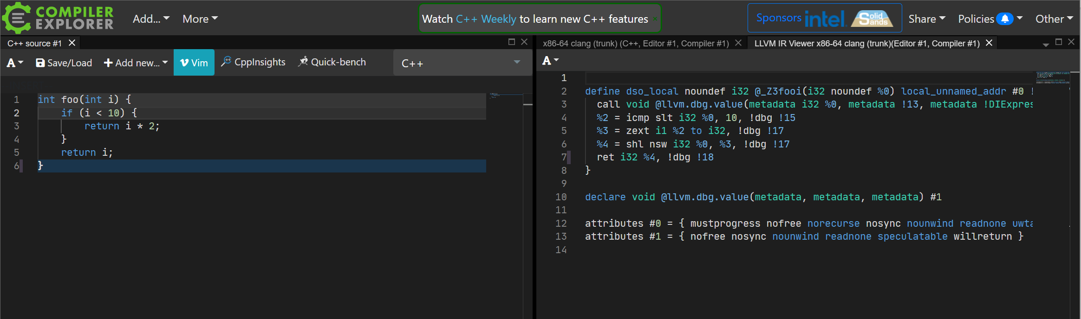
IR optimization
https://godbolt.org/z/YM6Wxno37

Slide 32
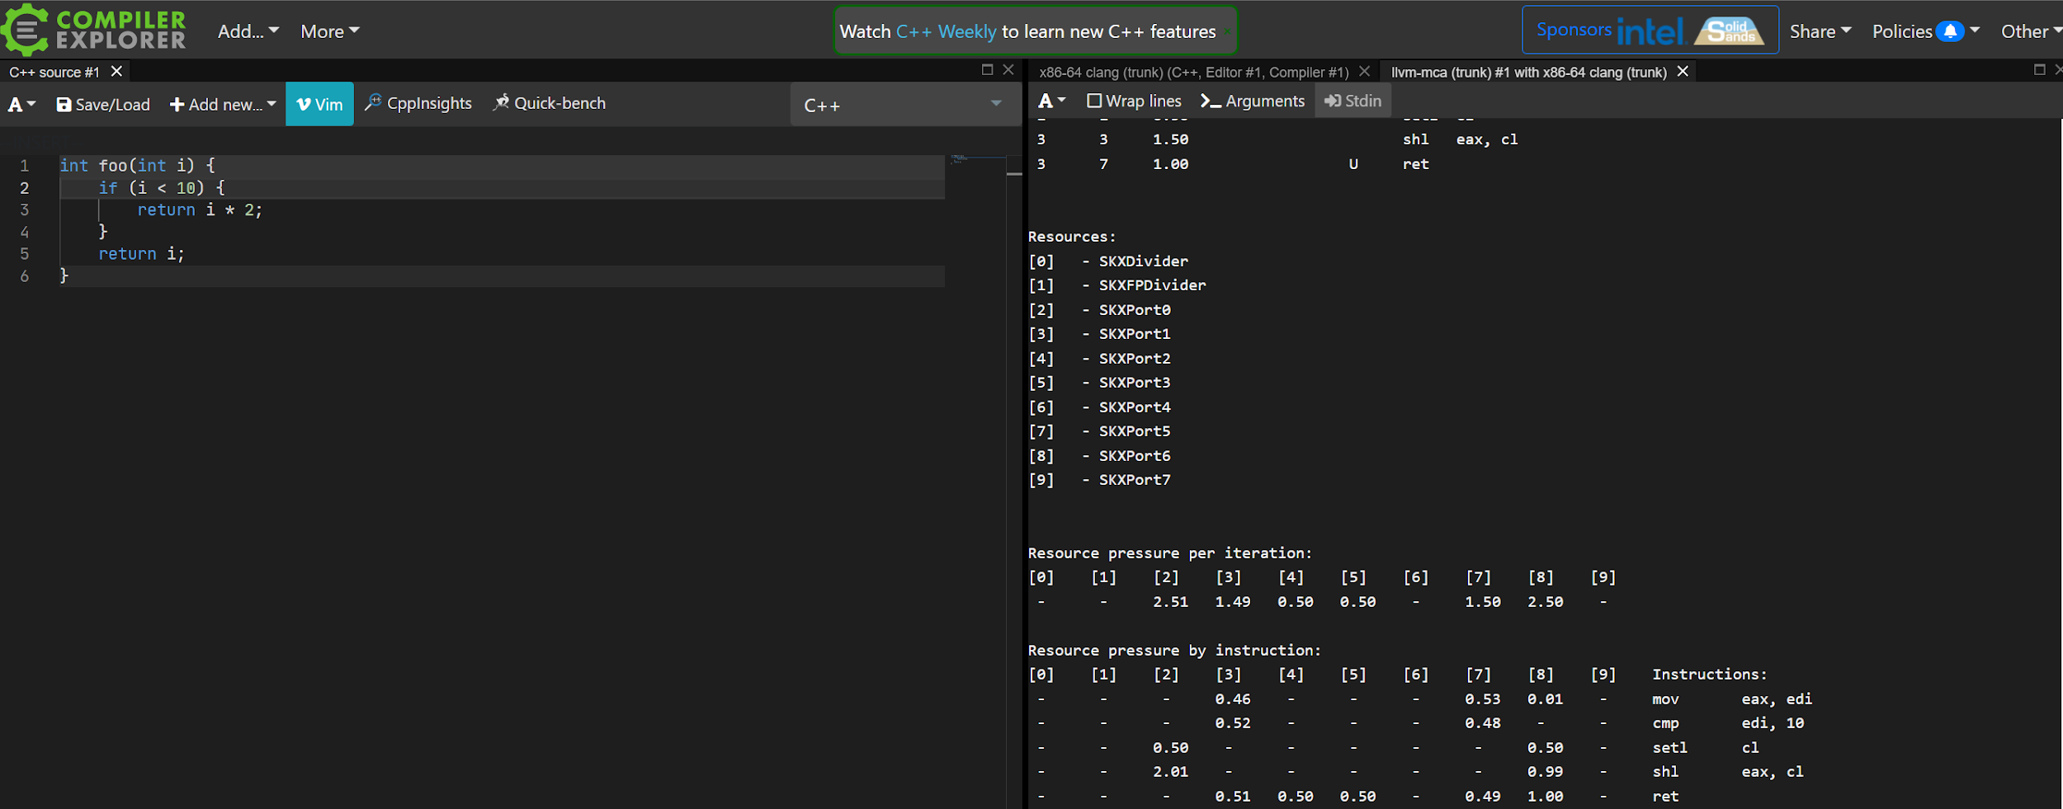
Code generation & optimization
https://godbolt.org/z/n3orv3Ydj

Slide 33
Linking
Compiler operates on Translation Units
Each translation unit produces an object file
Linker assembles multiple object files and libraries into a program
Not covered in this course
A few pointers for those, who want to know more about linkers
How the C++ Linker Works – YouTube
2017 LLVM Developers’ Meeting: R. Ueyama “lld: A Fast, Simple, and Portable Linker” - YouTube

Slide 34
Debugging
Compilers try to preserve source code <-> binary mapping
They’re not very successful when optimizations are involved
Debug info is stored in a special format within a binary or in a separate file: lookup DWARF and PDB
Debuggers get help from OS and hardware to enable breakpoints
Will be covered in this course (stretch goal)
More info:
2016 EuroLLVM Developers' Meeting: D. Panickal & A. Warzynski "LLDB Tutorial: Adding debugger ..." – YouTube
2013 LLVM Developers’ Meeting: “Adapting LLDB for your hardware: Remote Debugging the Hexagon DSP” - YouTube

Slide 35
Static analysis
Humans are not very good at computer programming
Lack of context, poor cognitive skills
ASTs and IRs can be used to help developers find bugs
Examples:
clang-tidy, PVS Studio, cppcheck, basically any IDE
More advanced: Rust borrow checker
Will be covered in this course
More info:
C++ Weekly - Ep 3 Intro to clang-tidy – YouTube
2020 LLVM Developers’ Meeting: “Using Clang-tidy for Customized Checkers and Large Scale Source...” - YouTube

Slide 36

LLVM
Compiler framework
Includes LLVM IR and backends for many platforms
Started by Chris Lattner in 2001
Multiple frontends under LLVM umbrella: clang, flang
Photo: https://www.modular.ai/team

Slide 37
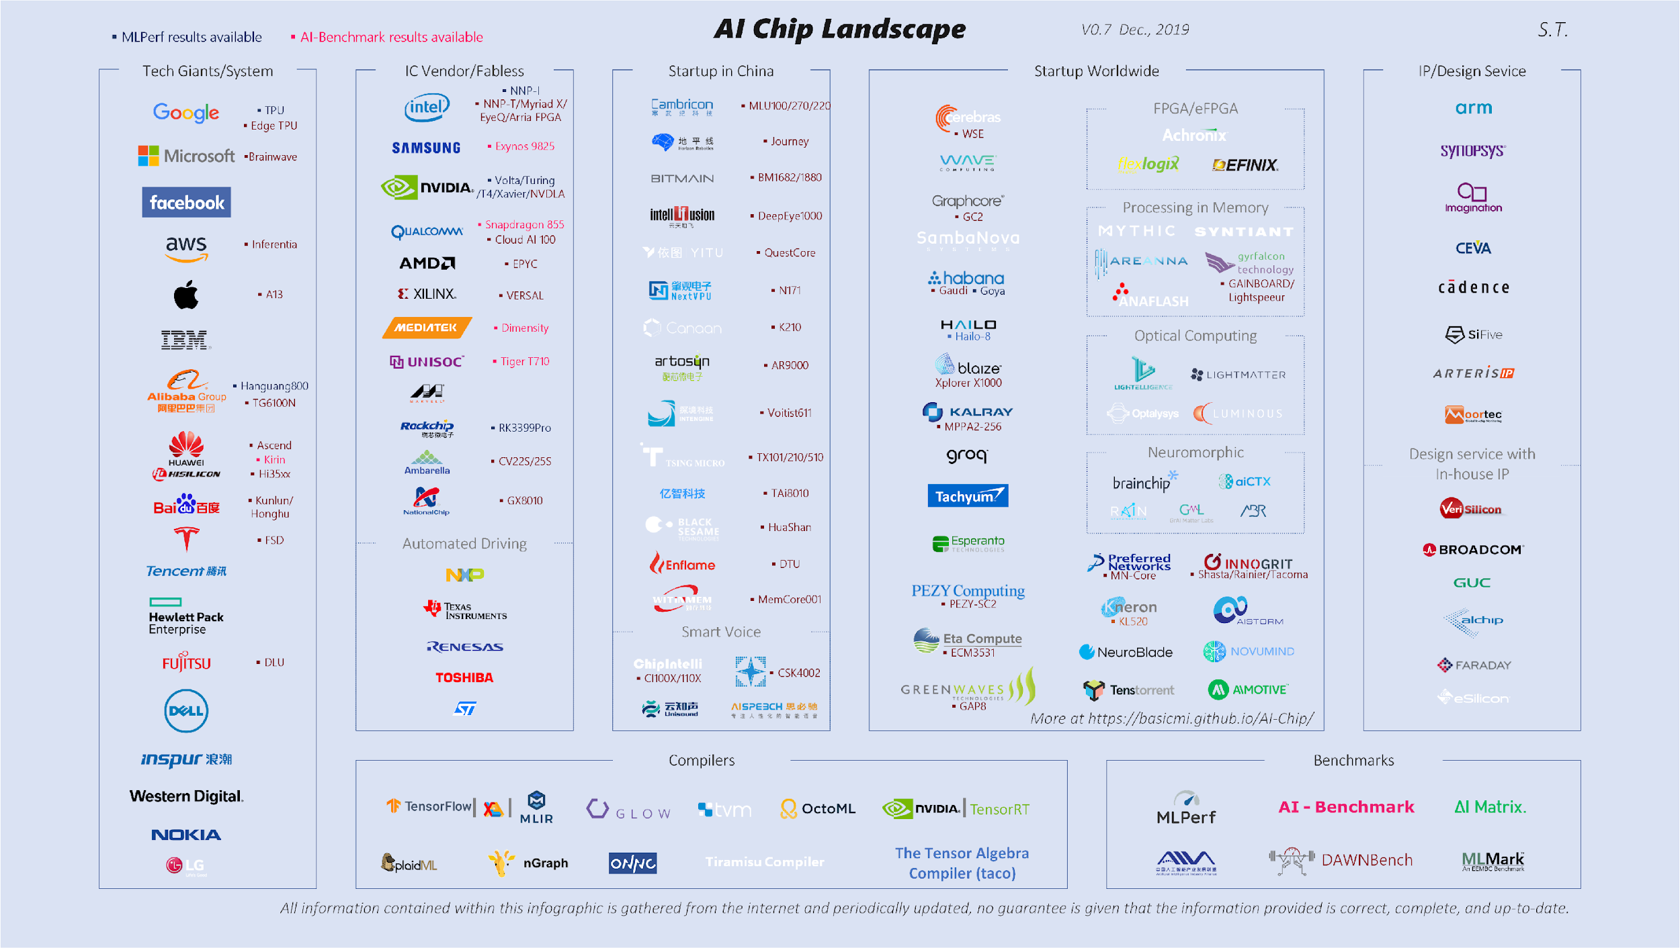
Hardware diversity
https://basicmi.github.io/AI-Chip/

Slide 38
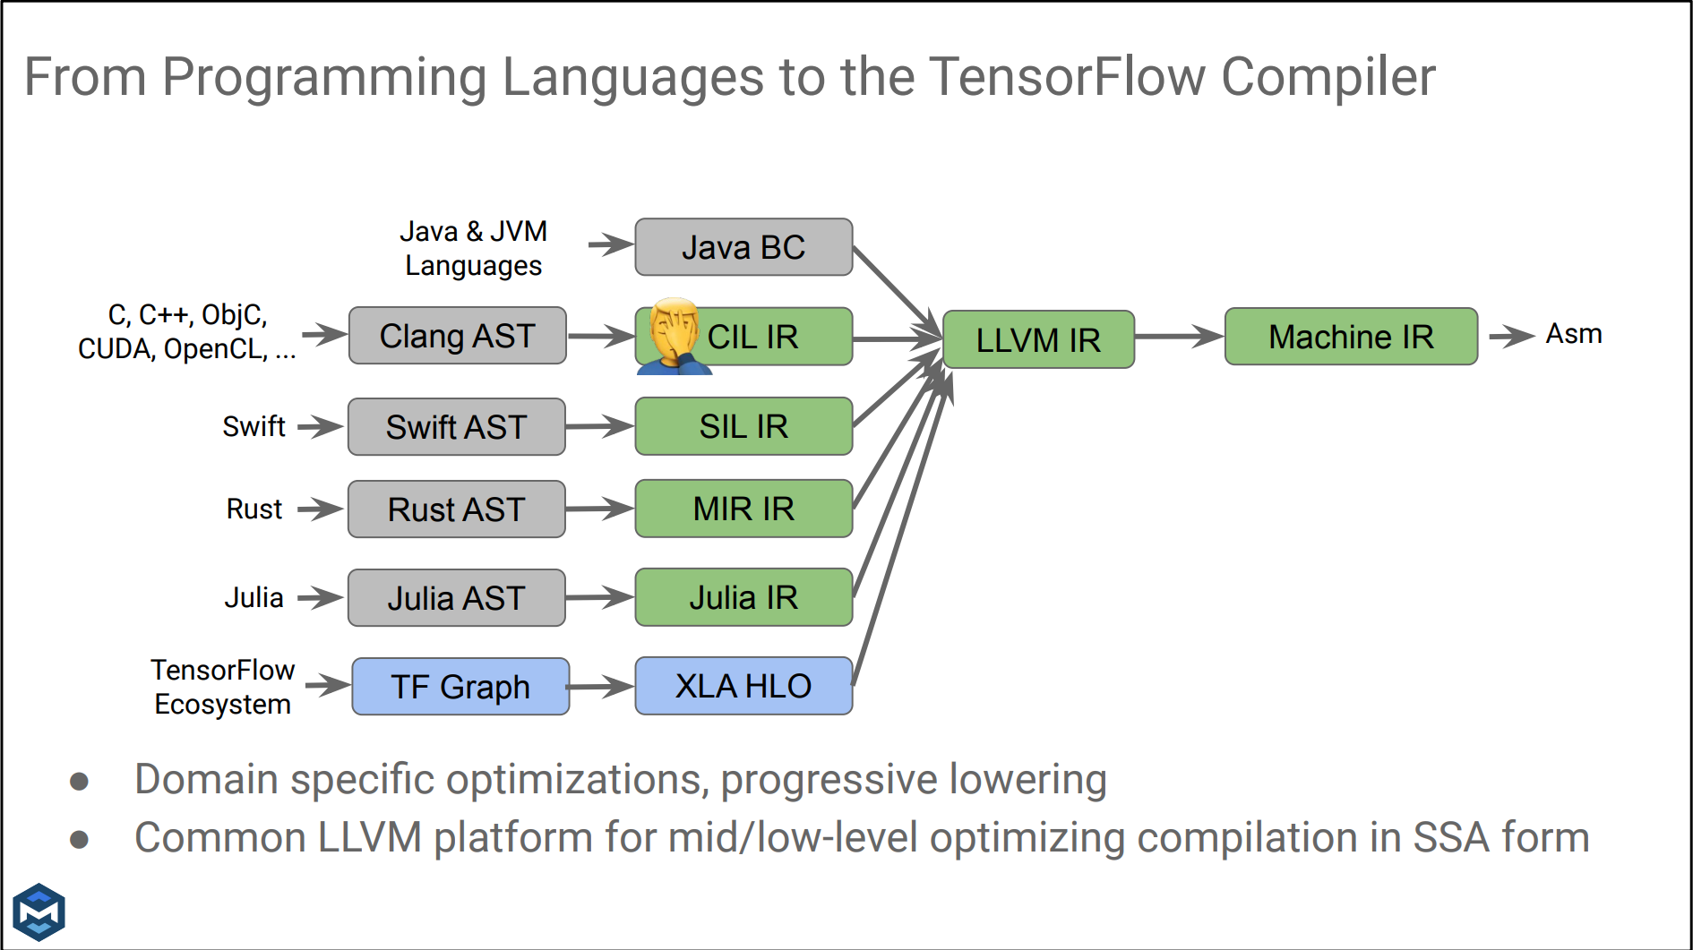
Post-modern compilers
https://llvm-hpc-2020-workshop.github.io/presentations/llvmhpc2020-amini.pdf

Slide 39




AI compilers
PyTorch
ONNX
Tensorflow
ATen dialect
ONNX dialect
TF dialect
Triton
Triton dialect
LLVM IR
Machine IR
Photo:
https://pytorch.org/assets/brand-guidelines/PyTorch-Brand-Guidelines.pdf
https://www.tensorflow.org/extras/tensorflow_brand_guidelines.pdf
https://artwork.lfaidata.foundation/projects/onnx/
https://triton-lang.org/main/index.html
`
Target HW

Slide 40
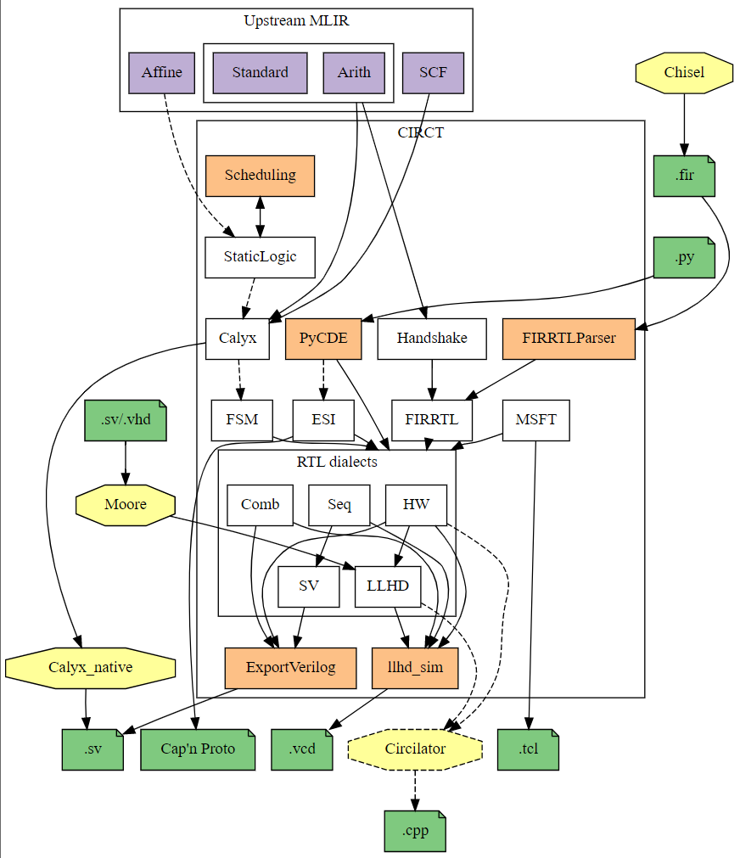
Customized hardware
“CIRCT” / Circuit IR Compilers and Tools
Compilers help design custom hardware
Reduce cost of development and validation
https://circt.llvm.org/

Slide 41
Career paths
hardware vendors
large software companies
AI development

Slide 42
In the next episode…
Compiler frontends
Different frontend stages: lexers, syntax, sema
Clang as an example

Slide 43
Extra materials
Interview with Jim Keller
Part 1: https://www.youtube.com/watch?v=Nb2tebYAaOA
Part 2: https://www.youtube.com/watch?v=G4hL5Om4IJ4
Interview with Chris Lattner
Part 1: https://www.youtube.com/watch?v=yCd3CzGSte8
Part 2: https://www.youtube.com/watch?v=nWTvXbQHwWs
An overview of Clang, LLVM Dev 2019 - https://www.youtube.com/watch?v=5kkMpJpIGYU
Compilers: Principles, Techniques, and Tools (aka the dragon book) - https://suif.stanford.edu/dragonbook/
What Has My Compiler Done for Me Lately? (Matt Godbolt) - https://www.youtube.com/watch?v=bSkpMdDe4g4
Engineering a Compiler (Keith D. Cooper & Linda Torczon) - https://github.com/lighthousand/books/blob/master/Engineering%20A%20Compiler%202nd%20Edition%20by%20Cooper%20and%20Torczon.pdf
Chandler Carruth
Tuning C++: Benchmarks, and CPUs, and Compilers! Oh My! - https://www.youtube.com/watch?v=nXaxk27zwlk
High Performance Code 201: Hybrid Data Structures - https://www.youtube.com/watch?v=vElZc6zSIXM

